Slide 1

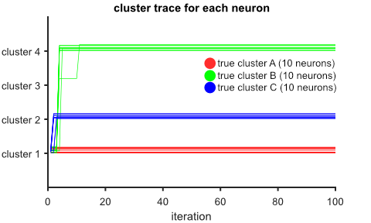
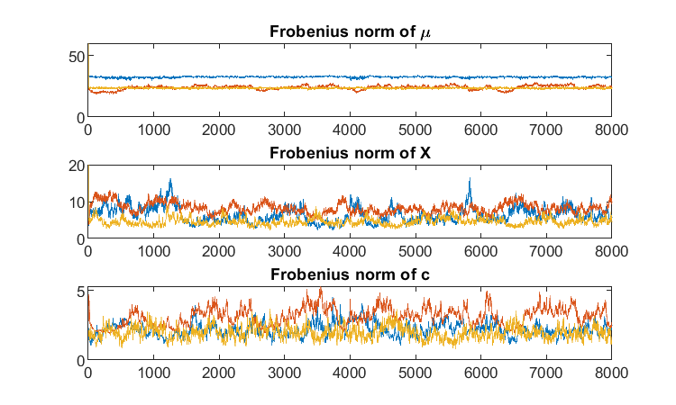
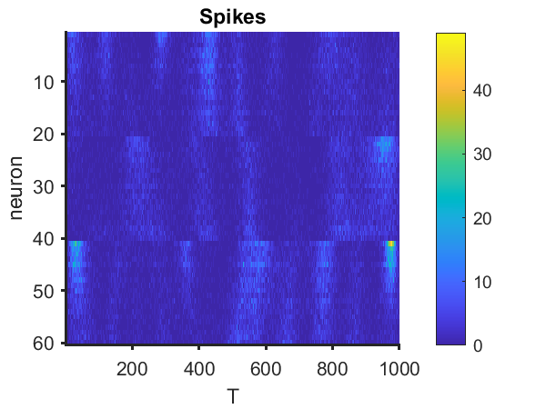
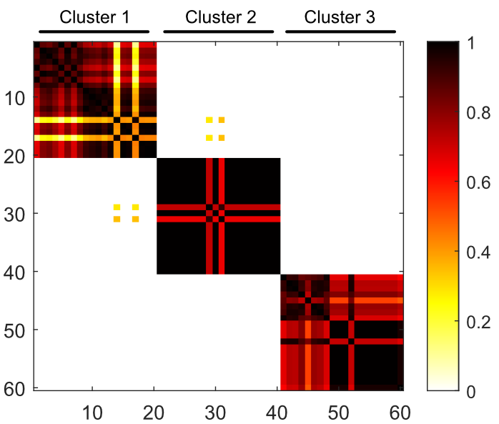
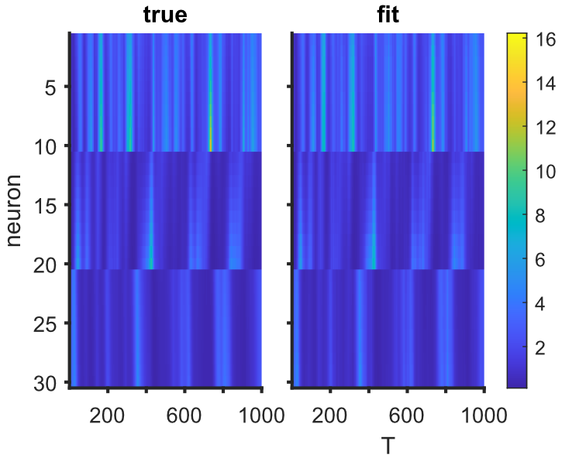
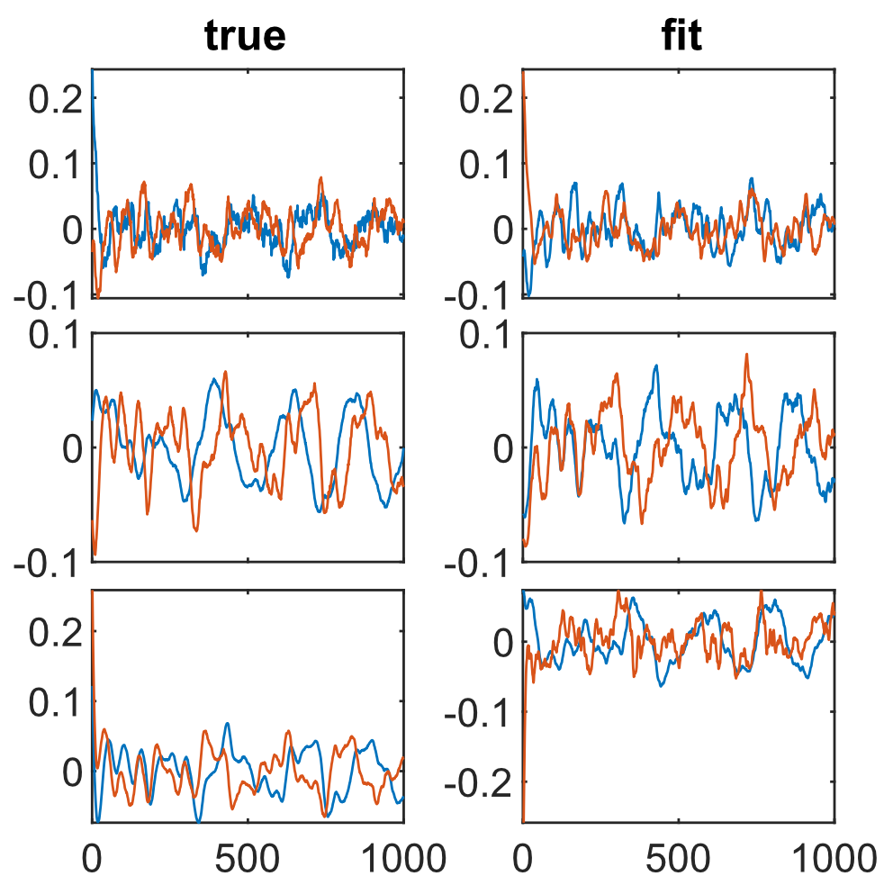
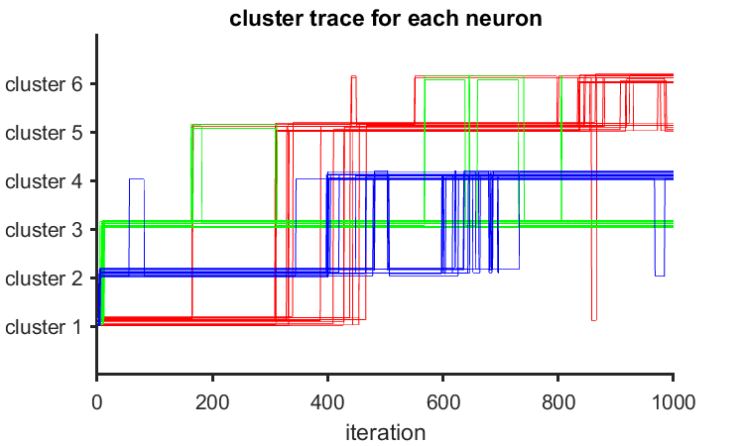
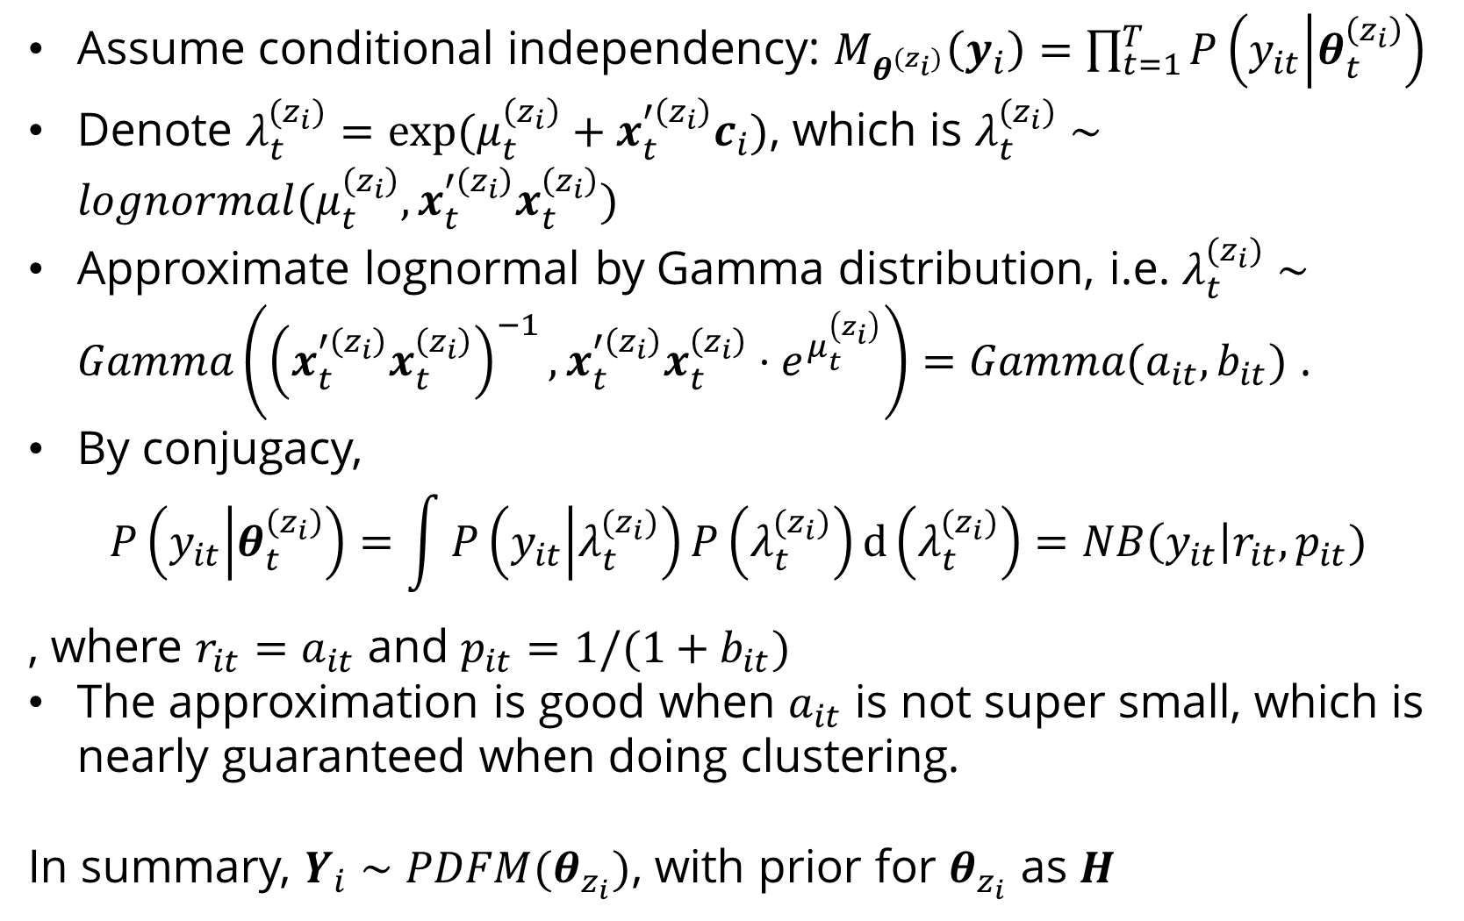
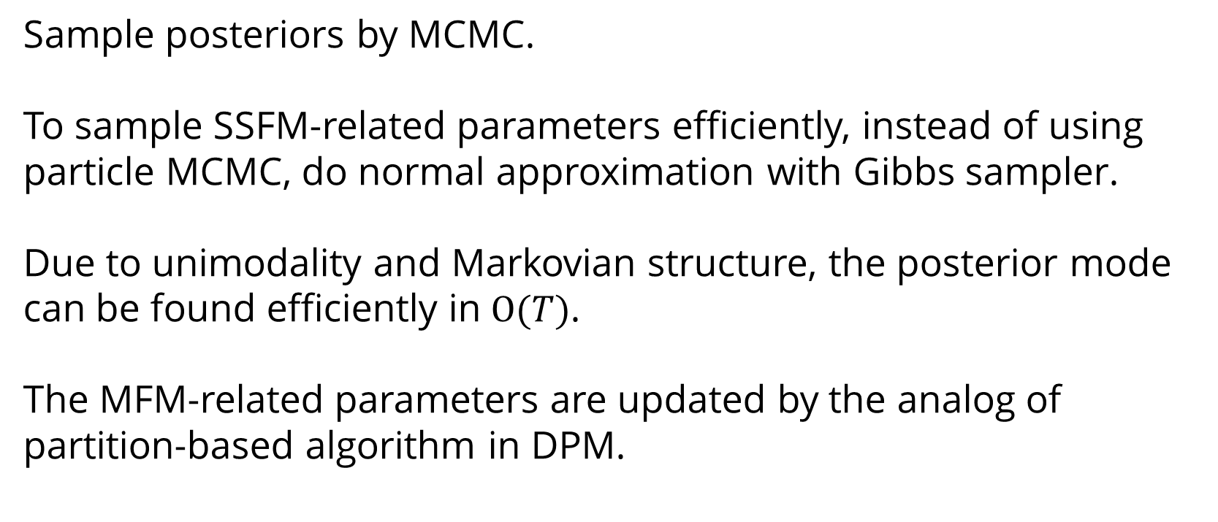
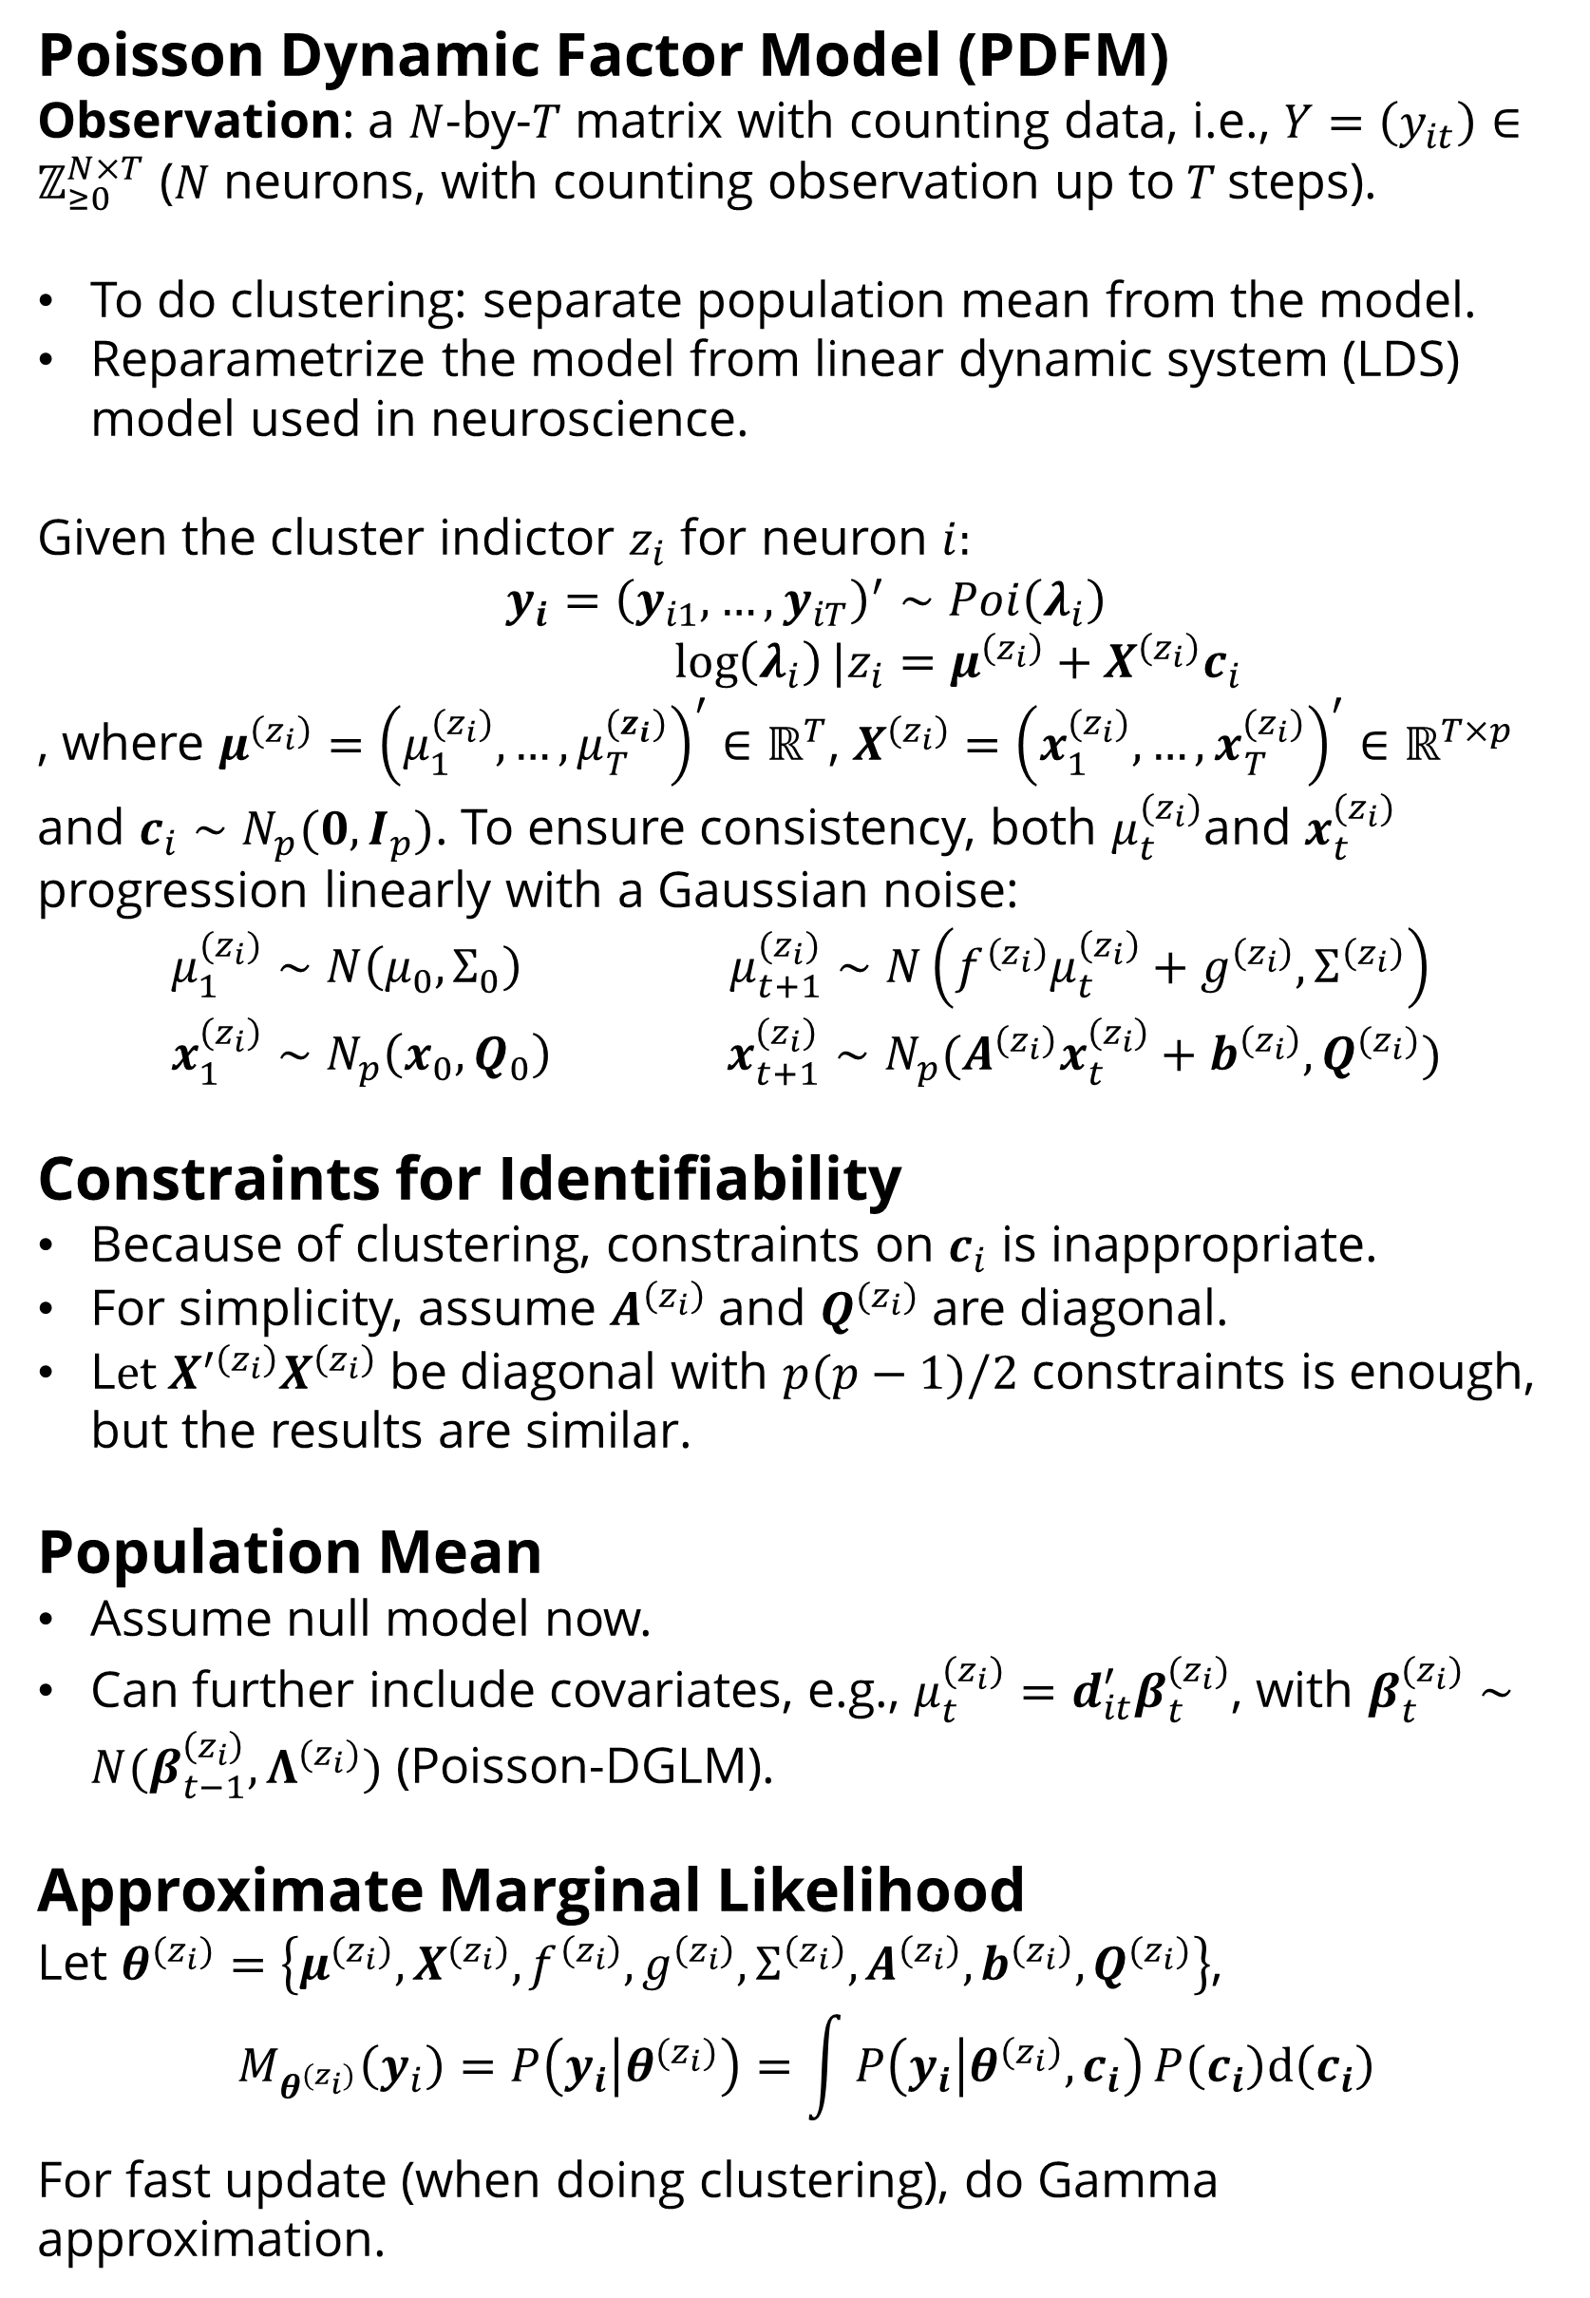
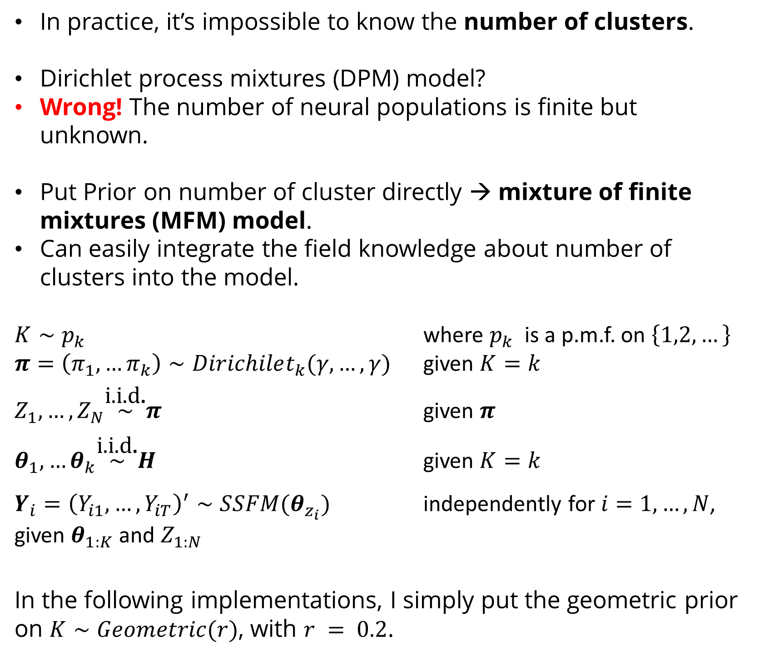
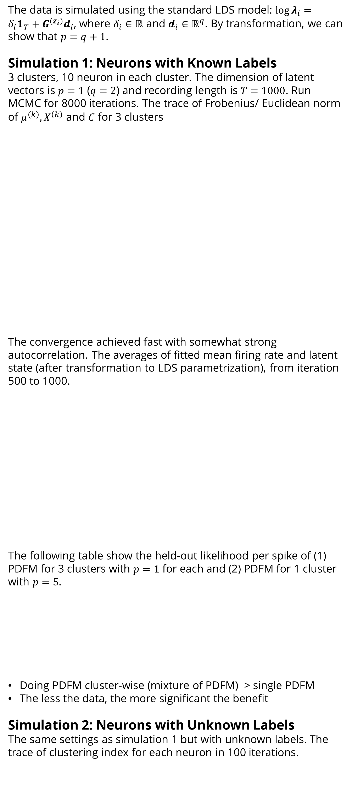
Clustering Neural Populations by Poisson Dynamic Factor Model
Ganchao Wei
University of Connecticut, Department of Statistics
Introduction
Assume conditional independency: $M_{θ^{(z_{i})}}\left(y_{i}\right)=\prod_{t=1}^{T}{P\left(y_{it} | θ_{t}^{\left(z_{i}\right)}\right)}$
Denote $λ_{t}^{(z_{i})}=\exp{(μ_{t}^{\left(z_{i}\right)}+x_{t}^{′\left(z_{i}\right)}c_{i})}$, which is $λ_{t}^{(z_{i})}∼lognormal(μ_{t}^{\left(z_{i}\right)},x_{t}^{′\left(z_{i}\right)}x_{t}^{\left(z_{i}\right)})$
Approximate lognormal by Gamma distribution, i.e. $λ_{t}^{(z_{i})}∼Gamma\left({\left(x_{t}^{′\left(z_{i}\right)}x_{t}^{\left(z_{i}\right)}\right)}^{−1},x_{t}^{′\left(z_{i}\right)}x_{t}^{\left(z_{i}\right)}⋅e^{μ_{t}^{\left(z_{i}\right)}}\right)=Gamma(a_{it}, b_{it})$ .
By conjugacy,
$$P\left(y_{it} | θ_{t}^{\left(z_{i}\right)}\right)=\int{P\left(y_{it} | λ_{t}^{(z_{i})}\right)}P\left(λ_{t}^{(z_{i})}\right)d\left(λ_{t}^{(z_{i})}\right)=NB\left(y_{it}\right|r_{it},p_{it})$$
, where $r_{it}=a_{it}$ and $p_{it}=1/(1+b_{it})$
The approximation is good when $a_{it}$ is not super small, which is nearly guaranteed when doing clustering.
In summary, $Y_{i}∼PDFM(θ_{z_{i}})$, with prior for $θ_{z_{i}}$ as $H$
Simulations
Simulation 3: Same waveform, different amplitude
20 neurons in each cluster
Same waveform, different amplitude
Most have weak signals
. The spiking counts and the posterior similarity matrix, from iteration 500 to 1000.
The trace of clustering index
High-density silicon probes and large-scale calcium imaging methods allow neuroscientists to study neurons in the multi-population level.
We are mostly interested in time-varying relationships within and between neural populations, which can usually be captured by low-dimensional latent state vectors. Both AR(1) and Gaussian process (GP) are widely used models for latent vectors.
However, defining the populations is usually difficult. Moreover, single factor model provides a global linear model in a lower-dimensional subspace, which is not suitable for non-linear case.
Here, we did clustering by Poisson dynamic factor model (PDFM), which (1) help to classify the neural population, and (2) describe global linear structure by local linear factor model.
This method is useful for general multiple time series for counting data.
The data is simulated using the standard LDS model: $\log{λ_{i}}=δ_{i}1_{T}+G^{(z_{i})}d_{i}$, where $δ_{i}∈ℝ$ and $d_{i}∈ℝ^{q}$. By transformation, we can show that $p=q+1$.
Simulation 1: Neurons with Known Labels
3 clusters, 10 neuron in each cluster. The dimension of latent vectors is $p=1$ ($q=2$) and recording length is $T=1000$. Run MCMC for 8000 iterations. The trace of Frobenius/ Euclidean norm of $μ^{(k)}, X^{(k)}$ and $C$ for 3 clusters
The convergence achieved fast with somewhat strong autocorrelation. The averages of fitted mean firing rate and latent state (after transformation to LDS parametrization), from iteration 500 to 1000.
The following table show the held-out likelihood per spike of (1) PDFM for 3 clusters with $p=1$ for each and (2) PDFM for 1 cluster with $p=5$.
Doing PDFM cluster-wise (mixture of PDFM) > single PDFM
The less the data, the more significant the benefit
Simulation 2: Neurons with Unknown Labels
The same settings as simulation 1 but with unknown labels. The trace of clustering index for each neuron in 100 iterations.
Models for Clustering: MFM
In practice, it’s impossible to know the number of clusters.
Dirichlet process mixtures (DPM) model?
Wrong! The number of neural populations is finite but unknown.
Put Prior on number of cluster directly → mixture of finite mixtures (MFM) model.
Can easily integrate the field knowledge about number of clusters into the model.
$K∼p_{k}$ where $p_{k}$ is a p.m.f. on $\left\{1,2,…\right\}$
$π=\left(π_{1},…π_{k}\right)∼Dirichilet_{k}(γ,…,γ)$ given $K=k$
$Z_{1},…,Z_{N}\overset{\text{i}\text{.}\text{i}\text{.}\text{d}\text{.}}{\sim }π$ given $π$
$θ_{1},…θ_{k}\overset{\text{i}\text{.}\text{i}\text{.}\text{d}\text{.}}{\sim }H$ given $K=k$
$Y_{i}={\left(Y_{i1},…,Y_{iT}\right)}^{′}∼SSFM(θ_{z_{i}})$ independently for $i=1,…,N$, given $θ_{1:K}$ and $Z_{1:N}$
In the following implementations, I simply put the geometric prior on $K∼Geometric(r)$, with $r = 0.2$.
Models for Neural Population: PDFM
Poisson Dynamic Factor Model (PDFM)
Observation: a $N$-by-$T$ matrix with counting data, i.e., $Y=\left(y_{it}\right)∈ℤ_{≥0}^{N×T}$ ($N$ neurons, with counting observation up to$T$steps).
To do clustering: separate population mean from the model.
Reparametrize the model from linear dynamic system (LDS) model used in neuroscience.
Given the cluster indictor $z_{i}$ for neuron $i:$
$$y_{i}={\left(y_{i1},…,y_{iT}\right)}^{′}∼Poi\left(λ_{i}\right) \\ \log\left(λ_{i}\right)|z_{i}=μ^{\left(z_{i}\right)}+X^{\left(z_{i}\right)}c_{i}$$
, where $μ^{\left(z_{i}\right)}={\left(μ_{1}^{(z_{i})},…,μ_{T}^{(z_{i})}\right)}^{′}∈ℝ^{T}$, $X^{\left(z_{i}\right)}={\left(x_{1}^{(z_{i})},…,x_{T}^{(z_{i})}\right)}^{′}∈ℝ^{T×p}$ and $c_{i}∼N_{p}(0,I_{p})$. To ensure consistency, both $μ_{t}^{(z_{i})}$and $x_{t}^{(z_{i})}$ progression linearly with a Gaussian noise:
$$μ_{1}^{(z_{i})}∼N\left(μ_{0},Σ_{0}\right) μ_{t+1}^{(z_{i})}∼N\left(f^{\left(z_{i}\right)}μ_{t}^{\left(z_{i}\right)}+g^{\left(z_{i}\right)}, Σ^{\left(z_{i}\right)}\right) \\ {x_{1}^{\left(z_{i}\right)}∼N_{p}\left(x_{0},Q_{0}\right) x}_{t+1}^{\left(z_{i}\right)}∼N_{p}(A^{\left(z_{i}\right)}x_{t}^{\left(z_{i}\right)}+b^{\left(z_{i}\right)}, Q^{(z_{i})})$$
Constraints for Identifiability
Because of clustering, constraints on $c_{i}$ is inappropriate.
For simplicity, assume $A^{\left(z_{i}\right)}$ and $Q^{(z_{i})}$ are diagonal.
L$et X^{′\left(z_{i}\right)}X^{\left(z_{i}\right)}$ be diagonal with $p(p−1)/2$ constraints is enough, but the results are similar.
Population Mean
Assume null model now.
Can further include covariates, e.g., $μ_{t}^{(z_{i})}=d_{it}^{′}β_{t}^{(z_{i})}$, with $β_{t}^{(z_{i})}∼N(β_{t−1}^{\left(z_{i}\right)},Λ^{(z_{i})})$ (Poisson-DGLM).
Approximate Marginal Likelihood
Let $θ^{(z_{i})}=\left\{μ^{(z_{i})}, X^{(z_{i})},f^{\left(z_{i}\right)},g^{\left(z_{i}\right)},Σ^{\left(z_{i}\right)},A^{\left(z_{i}\right)},b^{\left(z_{i}\right)},Q^{(z_{i})}\right\}$,
$$M_{θ^{(z_{i})}}\left(y_{i}\right)=P\left(y_{i} | θ^{(z_{i})}\right)=\int{P\left(y_{i} | θ^{\left(z_{i}\right)},c_{i}\right)}P\left(c_{i}\right)d\left(c_{i}\right)$$
For fast update (when doing clustering), do Gamma approximation.
Inference
Sample posteriors by MCMC.
To sample SSFM-related parameters efficiently, instead of using particle MCMC, do normal approximation with Gibbs sampler.
Due to unimodality and Markovian structure, the posterior mode can be found efficiently in $Ο(T)$.
The MFM-related parameters are updated by the analog of partition-based algorithm in DPM.
 |  | Sample 1 | Sample 2 | Sample 3 | Sample 4
3/4 training | 3 clusters | -0.8144 | -0.8036 | -0.8050 | -0.8196
 | 1 cluster | -0.8213 | -0.8056 | -0.8069 | -0.8225
1/2 training | 3 clusters | -0.8195 | -0.8118 | -0.8123 | -0.8213
 | 1 cluster | -0.8225 | -0.8241 | -0.8408 | -0.8356
Acknowledgements
I thank my advisors Dr. Ian H. Stevenson and Dr. Xiaojing Wang for detailed and constructive discussions, comments and suggestions.
References
Macke, J. H. et al. Empirical models of spiking in neural populations. Adv. Neural Inf. Process. Syst. 24, (2011).
Miller, J. W. & Harrison, M. T. Mixture models with a prior on the number of components. J. Am. Stat. Assoc. 113, 340 (2018).

